Slide 1
Topic Modeling
Inference and Representation
Ravi Choudhary (rc3620)

Slide 2
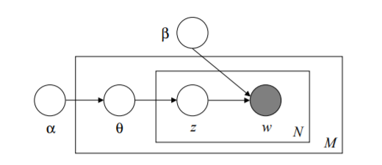
Latent Dirichlet Allocation
Algorithm Proposed by Blei et al.
Choose mixture of topics 𝜃= Dirichlet(⍺)
For each of the words:
Choose a topic z_{n} from the multinomial(𝜃)
Choose a word w_{n} from a multinomial p(w_{n}|z_{n},β)

Slide 3

Inference
p(𝜃, z|w, ⍺, β) = p(𝜃, z, w|⍺, β)/p(w|⍺, β)
To get p(w|⍺, β) we need to marginalize over hidden variables z, 𝜃. Exact inference is intractable.
Therefore we can use Variational Inference to approximate.
We use a function q such that
This function simplifies assumption by removing dependency between 𝜃, z.

Slide 4
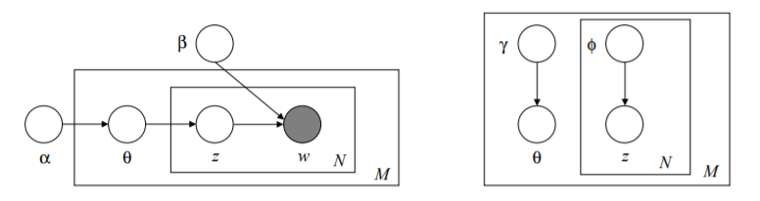
Variational Inference
New objective: Reduce D_{KL}(q(𝜃, z|𝜙,𝛾)||p(𝜃, z|w, ⍺, β) using ELBO.
Equating the derivative of the objective to zero results in 2 update equations for 𝜙, 𝛾. Solving them gives q.

Slide 5
AVITM
Autoencoding Variational Inference For Topic Models proposed by Srivastava et. al. tried to use VAE to with LDA.
In order to use the reparametrization trick, Laplace Approximation of Dirichlet prior was used.
Logistic Normal Distribution is a distribution of random variables whose logits have a normal distribution. Laplace Approximation to a dirichlet distribution is a Logistic Normal Distribution.
ELBO = -D_{KL}(q(𝜃, z|𝜙,𝛾)||p(𝜃, z|w, ⍺, β) + E_{q(𝜃, z|𝜙,𝛾)}[log(p(𝜃, z|w, ⍺, β))]

Slide 6
Prod LDA
Assumption: β is unnormalized. The document is created by a product of experts.
p(w_{n}|β, 𝜃) ∝ 𝚷_{k}p(w_{n}|z_{n}=k, β)^{𝛳}
This transforms the log-likelihood term to Σ count*log(p(w_{n}|z_{n}=k, β)).

Slide 7
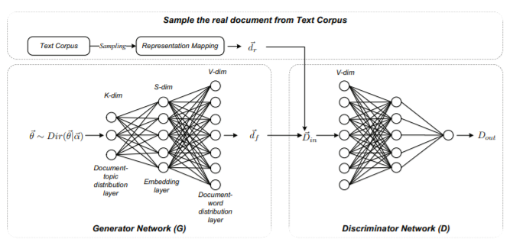
Adversarial Topic Modeling
Uses WGAN-GP for inference proposed by Wang et. al. in a recent paper.

Slide 8

WGAN-GP
Proposed in Improved Training of Wasserstein GANs by Gulrajani et. al.
Solves the problem with Wasserstein GAN of having to clip gradients for forcing the Lipschitz constraint by introducing a gradient penalty

Slide 9
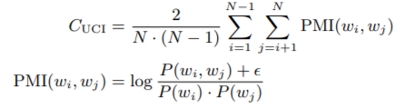
Evaluation Criteria
Topic Modeling is usually evaluated by 2 metrics - Perplexity Scores and Topic Coherence
Topic Coherence measure is calculated using joint probabilities of the top words in the topic based on a corpus.
Several type of topic coherence measures were evaluated by Roder et al. using correlation with human evaluated topics. They found that coherence measure C_{v} had highest correlation with human judgement.

Slide 10
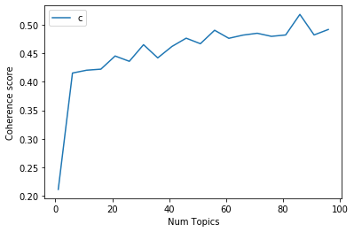
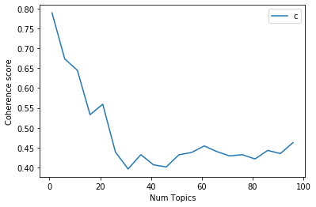
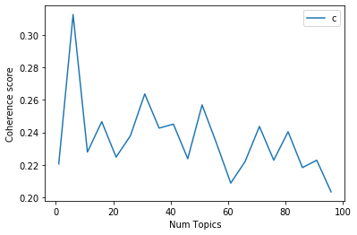
Comparison of Coherence Scores
Data - open datasets published by NASA
Online LDA
AVITM
ATM

Slide 11
Actual Topics
Model | Coherence (k = 5) | Sample Topic Associated Words
Online LDA | 0.40 | Space Missions - data, power, mission, navigation, high, network, phase, model, base, academy,space, spacecraft
AVITM | 0.75 | Chemistry - alkalis, physicochemical, solidify, catalysts, dry, lithograph, wastewater, hybridize, dioxide
ATM | 0.73 | Thermodynamics - internally, rotational, plight, pyrogen, subcooling, airmoss, intumescents, condensational

Slide 12
Issues
Wasserstein Distance in WGAN-GP kept on increasing.
Wiki Corpus couldn’t be used for Topic Coherence calculation because of redaction of organization names by NASA - which were not present in wiki corpus.

Slide 13
References
David M Blei, Andrew Y Ng, and Michael I Jordan. “Latent dirichlet allocation”. In: Journal of machine Learning research 3.Jan (2003), pp. 993–1022.
Diederik P Kingma and Max Welling. “Auto-encoding variational bayes”. In:arXiv preprint arXiv:1312.6114(2013).
Thomas N Kipf and Max Welling. “Variational graph auto-encoders”. In:arXiv preprint arXiv:1611.07308(2016).
Christopher E Moody. “Mixing dirichlet topic models and word embeddings to make lda2vec”. In:arXiv preprint arXiv:1605.02019(2016).
Michael R ̈oder, Andreas Both, and Alexander Hinneburg. “Exploring the space of topic coherence measures”. In:Proceedings of the eighth ACM international conference on Web search and data mining.ACM. 2015, pp. 399–408.
Akash Srivastava and Charles Sutton. “Autoencoding variational inference for topic models”. In:arXivpreprint arXiv:1703.01488(2017).
Rui Wang, Deyu Zhou, and Yulan He. “Atm: Adversarial-neural topic model”. In:Information Pro-cessing & Management56.6 (2019), p. 102098.
Wells Fargo: Campus Analytics Challenge: Natural Language Processing.url:https://www.mindsumo.com/contests/campus-analytics-challenge-2019.

Slide 14
Thank You!

